Slide 1
Routing with Express.
Express: It’s a NodeJs framework/package/module for easily building web apps and APIs.
By OZZY

Slide 2
Get started with express
To make it available in our program
npm install express –save
We require express in our program/source code/ file

Slide 3
Basic routing with node-express
//server.js
 | const express = require('express'), server = express(); server.set('port', process.env.PORT || 3000); //Basic routes server.get('/', (request,response)=>{ response.send('Home page'); }); server.get('/about',(request,response)=>{ response.send('About page'); }); //Express error handling middleware server.use((request,response)=>{ response.type('text/plain'); response.status(505); response.send('Error page'); }); //Binding to a port server.listen(3000, ()=>{ console.log('Express server started at port 3000'); });
 | server = express();
 | server.set('port', process.env.PORT || 3000);
 | //Basic routes
 | server.get('/', (request,response)=>{
 | response.send('Home page');
 | });
 | server.get('/about',(request,response)=>{
 | response.send('About page');
 | });
 | //Express error handling middleware
 | server.use((request,response)=>{
 | response.type('text/plain');
 | response.status(505);
 | response.send('Error page');
 | });
 | //Binding to a port
 | server.listen(3000, ()=>{
 | console.log('Express server started at port 3000');
 | });

Slide 4
Serving html pages
First method
app.get('/', (req, res) => { res.sendFile('./landing-page/home.html', { root: __dirname }); });
app.get('/about', (req, res) => {
res.sendFile('./landing-page/about.html’, {
root: __dirname }); });
app.get('/contact', (req, res) => { res.sendFile('./landing-page/contact.html', { root: __dirname }); });

Slide 5
Method two-serving html files with nodejs
const express = require('express');
const app = express();
app.use(express.static('./public'));
app.listen(3000);
Then load any html file in the public folder
Notes:
app.listen(3000, function(error){
if(error) throw error
console.log("Server created Successfully")
})
app.listen(port, () => console.log(`App listening on port ${port}!`))

Slide 6
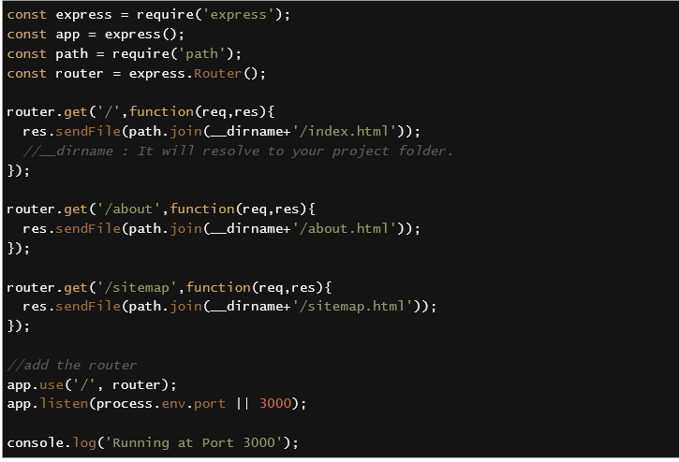
Method 3 serving html
Using express route

